Slide 1

Predicting Customer Churn for a Telecom Company
Presented By Info Miners
Prajay Reddy Minuka
Rakesh Chitrala
Kusuma Yalamarthi
Srija Thota

Slide 2
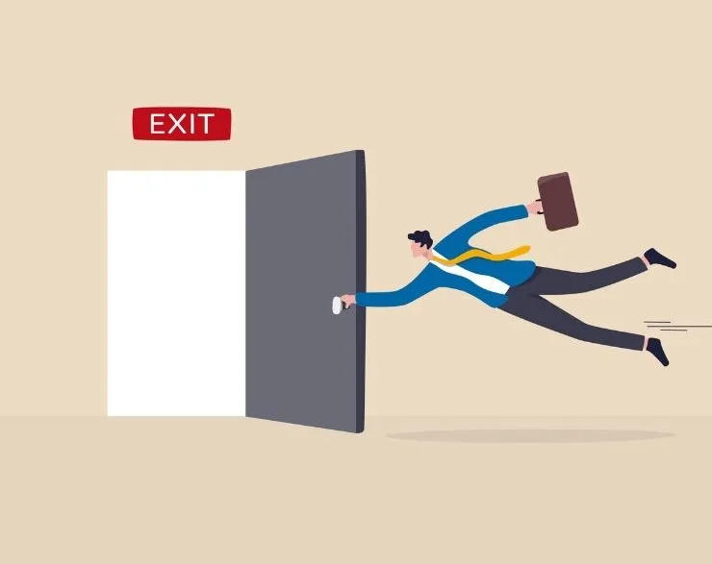
Introduction
What is Churning?

Slide 3

Business Problem and Motivation
•Over the past decade, the telecommunications industry has witnessed a rapid increase in the number of users.
•Churn has emerged as a significant challenge, leading to substantial financial repercussions.
•Acquiring a new customer can cost up to five times more than retaining an existing one.
•Retaining customers is crucial for sustaining revenue and ensuring long-term profitability.

Slide 4

Objective and Goals
Primary objective: Develop a predictive model to identify customers at risk of churning.
Key goals:
•Build an accurate classification model.
•Conduct a comprehensive analysis to support retention strategies.

Slide 5

Real World Impact of using Business Analytics
According to Forbes, customer acquisition cost in 2020 was as high as $325.
In a scenario with 10,000 customers at risk of churning, implementing a churn prediction model can lead to large savings.
•Cost of acquiring 10,000 customers = $325 x 10,000 = $3,250,000
•Cost of retaining customers = $50 x 10,000 = $500,000
•Cost Savings = Cost of acquiring new customers - Cost of retaining customers
•Cost Savings = $3,250,000 - $500,000 = $2,750,000
This calculation illustrates the significant cost savings associated with the churn prediction model.
By retaining 10,000 customers at the risk of churning, the company could save up to $2,750,000.

Slide 6

DETAILS OF THE DATASET
Dataset sourced from an Iranian telecom company.
3150 rows, 13 columns.
Churn column serves as the target variable.
All columns, except the churn column, represent aggregated data for the initial 9 months.
The churn column reflects the customer's status after 12 months, the three-month interval is for implementing retention strategies.

Slide 7

METHODOLOGY AND APPROACH
Implemented supervised classification algorithms
Incorporated the following stages into our project implementation:
Exploratory Data Analysis
Preprocessing the dataset.
Training and testing a variety of classification methods.
Choosing the best model based on a metric suitable for the business case.
Hyper-Parameter tuning for the chosen model.

Slide 8

Choice of Metric
False Positive (FP): When the model incorrectly predicts customers as being at risk of churning when they are not.
False Negative (FN): Model incorrectly predicts customers as not being at risk of churning when they are.
We have selected two primary metrics for evaluating the performance of our churn prediction model: Recall and F2 Score.

Slide 9
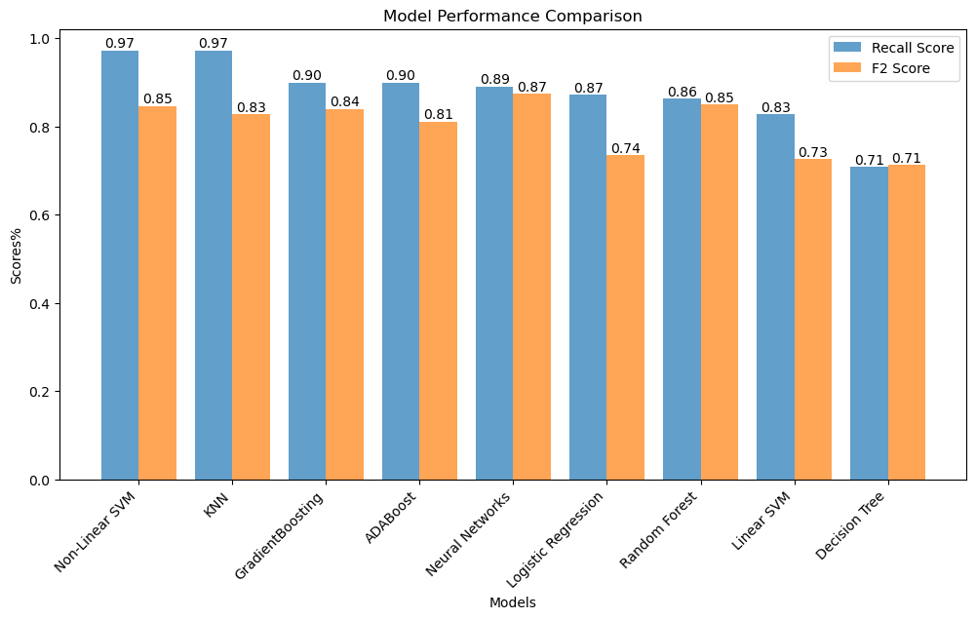
Results

Slide 10
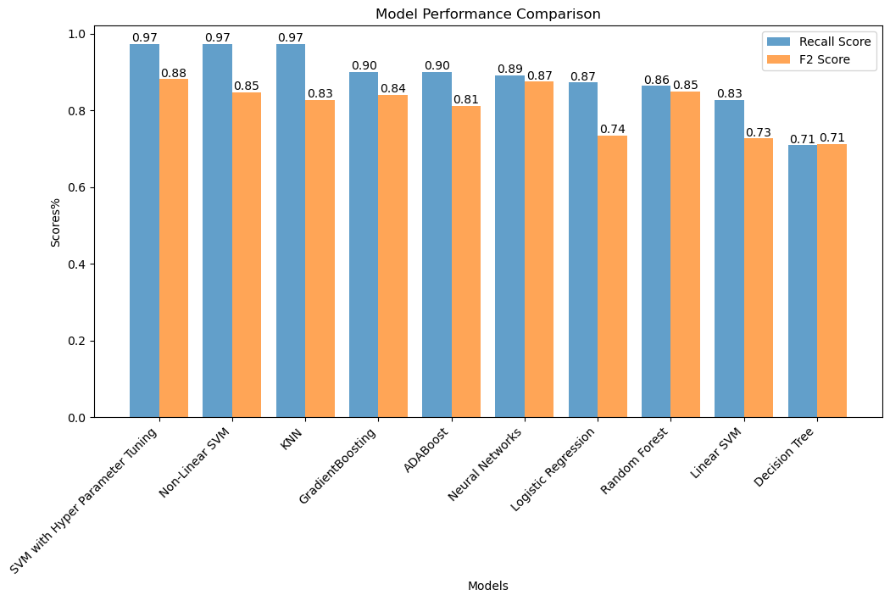
Results

Slide 11
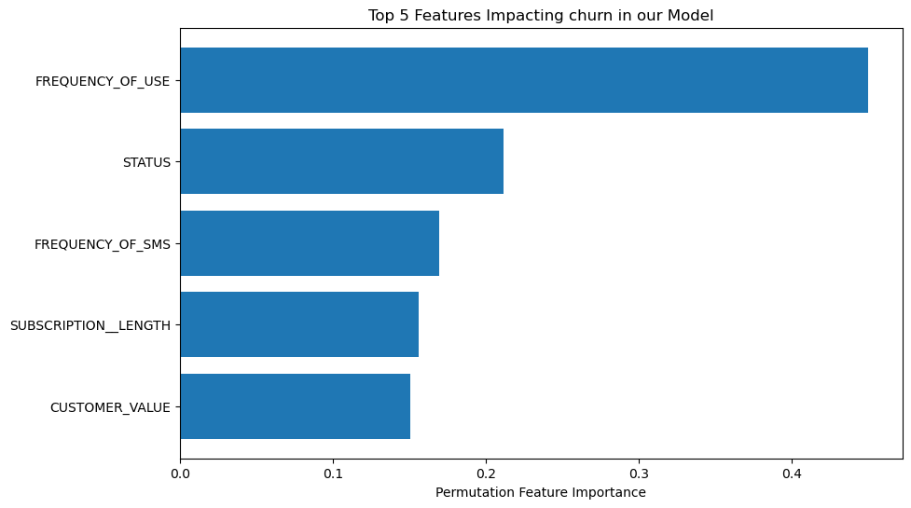
Features Impacting Churn

Slide 12

How the Model can be Used
Identifying At-Risk Customers
Customer Segmentation for Enhanced Strategy
Customer Segmentation for Enhanced Strategy

Slide 13

Thankyou

